Slide 1
CHAPTER 1: The environment of Last Mile Distribution logistics
UNIT 3: Variety of product flows in the LMD ecosystem
Capsule
1.3.3
Retail outlets distribution

Slide 2
To be done prior to this capsule:
This capsule builds on the knowledge acquired in capsule 1.3.1. It should therefore be done after capsule 1.3.1.
Capsule linked with:
Link with the topics of capsules 1.2.1, 1.2.4, 1.4.1, 1.4.4, 2.1.1, 2.3.2, 2.5.3, 2.5.4, 2.5.5.
Authors:
AFT, SUSMILE consortium partner

Slide 3
Objectives of the Capsule
Presentation of the specifics of retail logistics when delivering items to points of sale within the city. Relating back to elements of capsule 1.3.1 and presenting the organisation of urban logistics for this specific activity through its operational constraints, performance objectives and evolutions.
Category | E-learning | EQF
 |  | 4 | 5 | 6
 |  | X | X | X
Exercises included | YES
Effort for the capsule | Content 35 Min. | Exercises 15 Min. | Extra material 0 Min.

Slide 4
Content of the Capsule
Introduction to the specificities of retail products
Organisation of urban logistics for retail outlets
Constraints & innovations in retail distribution mechanisms

Slide 5
Elements of understanding
This Capsule is an e-learning content, with animated messages and contents. In order to take full advantage of its content, please switch to “presentation” mode in order to browse all the key messages.
When looking for a definition or additional content, click on the following icon:
A small message box will open to provide additional information.
In case of doubt, you may refer to your teacher/professor or use the contact details of this MOOC designer team.

Slide 6
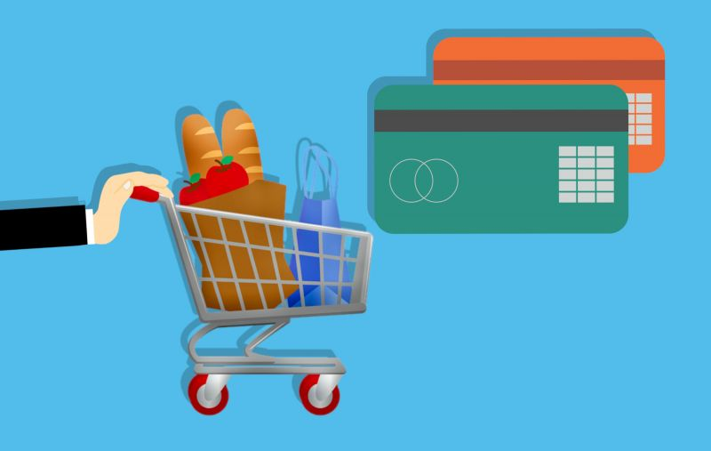
Introduction
Retail refers to the activity of selling goods or services directly to consumers or end-users.
Compared to Courier Express Parcel (CEP) operations, which are also related to retail activities, the focus of this capsule is related to the physical points of sale in the city.
Retail covers both goods and services, but we focus on logistics flows, thus on the distribution of goods.

Slide 7
Introduction
Retail distribution can take many forms, among which the most traditional one is to sell products directly to customers in a shop.
There are lots of business types concerned with the “retail distribution flows”, such as:
City and supermarkets
Clothing brands
Hotels, bars & restaurants (not addressed in this capsule but in the next one)
Fuel stations
Furniture stores
Book stores
Etc.

Slide 8
Introduction
The reason why “distribution of retail outlets” is a specific type of flow to be focused on is for the organisational similarities they have in common.
These aspects lead to specific logistic flows that can be comparable in terms of constraints and stakeholders involved.
Product
It usually starts with:
Place
Price
Customer
Promotion
Presentation
Personnel
The retail marketing mix
Notes:
All these factors will affect the business model of the points of sales and brands concerned with the logistic distribution flows we will be overviewing in this capsule. Though it’s a marketing/commercial concept, it’s closely related to logistics organisation and profitability.

Slide 9
A bit of history
Retailers have existed for as long as there has been evidence of trade among human civilisations.
Since their organisation was not planned at the beginning, few permanent shops existed. Sellers were often on the road or reaching out to customers with specific areas authorised for trade such as markets and fairs.
In the 17th century, permanent shops began to appear in almost all city markets. They were the first retail shopfronts and focused on the availability of goods and business transactions.
By the end of the 18th century multi-vendor spaces, and later shopping centres, were established in Europe.
From the mid-19th century onwards, mega-stores and warehouse-type buildings appeared to reflect the growing size of major stakeholders and populations’ density.
Indications now suggest that due to the strong development and competition from online retailers, stores are likely to reduce their size in the coming years.
Notes:
Please note there’s a lot of history on internet about retail businesses origins. We aim at providing a brief synthesis here.

Slide 10
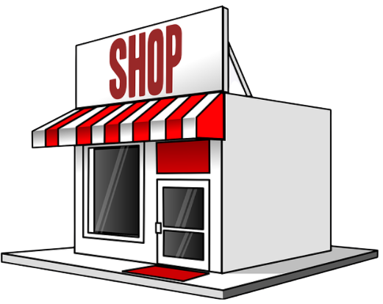
Recent evolutions
Specialised brand
Targeted product strategy
Multimode store
Multi-service store

Slide 11
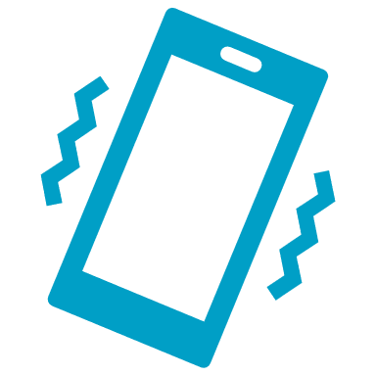
Recent evolutions
Identified as « specialists » of a certain type of product or services, retailers will value an expertise on a specific technology, maintenance issues, etc.
Targeted products strategy
More references,
but same kind of items
Better service quality and staff expertise
Less customer movements to find what they are looking for

Slide 12
Back
Recent evolutions
Targeted products strategy
Identified as « specialists » of a certain type of product or services, retailers will valorize an expertise over a specific technology, maintenance issues, etc.
This sales strategy leads to a good knowledge of the family of products displayed in order to gain a competitive advantage on advice and customer service.
It also matches the very opposite display of bazaars or « category killers » which tend to keep prices to a minimum by displaying a deep assortment of products.
There must be an important physical, multi-reference stock, to back this strategy.
More references,
but same nature of items
Better service quality and expertise of personnel
Less customer movements to find what they’re looking for

Slide 13
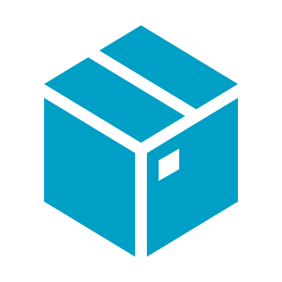
Recent evolutions
In order to secure their sales through a strong brand image, some retailers invest strongly on branding and develop their outlets to promote one product or service.
Specialised brand
…searching for a service or product and pay.
Customers can access a showroom in the city centre
Products are then shipped from another logistic site
…directly to their home or point of collection.

Slide 14
Back
Recent evolutions
Specialized brand
In order to secure their sales over a strong brand image, some retailers will invest strongly on branding and develop their point of sale to valorize one product or service.
This sales strategy is also called « drop shipping ».
Customers can pay online directly from the outlet, after being advised on the products they are looking for.
There is no available stock (for sale) in the shop.
…search for a service or product and pay.
Customers reach a « showroom » shop in the city centre
Products are then shipped from a another logistic site
…directly to their home or point of collection.

Slide 15
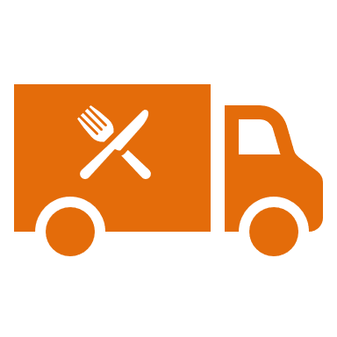
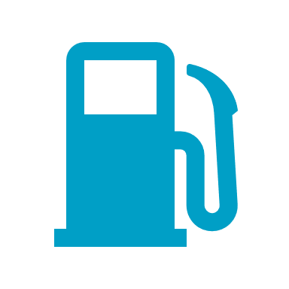
Recent evolutions
Due to the high competition among retailers, new services are often provided to attract customers to the outlet for other aspects than the original type of product/service.
Multi-service store
Energy access,
on-site product tasting…
Order preparation, pre-shopping service…
Home delivery,
Maintenance…

Slide 16
Back
Recent evolutions
Multi-services store
Due to the high competition among retailers, new services are often provided to attract customers to the point of sale for other aspects than the initial type of product/service.
This sales strategy implies new product types, hence new equipment and possibly other sources of procurement.
It affects the number and type of products on site, and therefore the logistics flows to fulfil them.
Energy access, on-site product tasting…
Order preparation, pre-shopping service
Home delivery

Slide 17
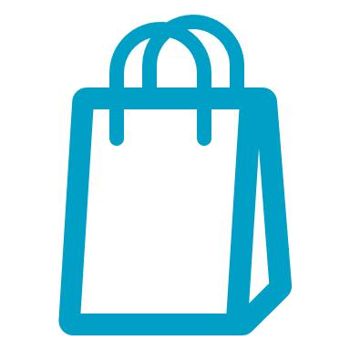
Recent evolutions
In order to compete with e-Commerce and home delivery, physical shops are developing new experiences for their customers.
Multimode store
Bulk sales, coupling food purchase & restaurant space
Experiencing, gaming, manipulating products…
Promotion of specific values such as environmental protection

Slide 18
Back
Recent evolutions
Multimode store
In order to face the competition with e-Commerce and home delivery, physical shops are developing new experiences for their customers.
This sales strategy requires a complete change of equipment and services within the available space, hence a specific sourcing to match their needs (i.e butchery and restaurant).
It affects the number and type of products on site, and therefore the logistics flows to fulfil them.
Bulk sales, coupling food purchase & restaurant space
Experiencing, gaming, manipulating products…
Valorising specific values such as environment protection

Slide 19
Self-evaluation quiz
A retail point of sale allows you to buy:
❑ Only a few types of products
❑ Only brand new items
❑ Any products or services
❑ Only non-branded products

Slide 20
Self-evaluation quiz
In the “Retail Marketing Mix”, the sales strategy is centered on:
❑ The products
❑ The customers
❑ The services
❑ The margins

Slide 21
Operational modalities
Organisation of the retail outlets distribution
A retailer’s strategy to sell its products or services is related to the multiple factors expressed in the marketing mix.
Place
The location of the store is strategic in terms of visibility, customer traffic, available space, opening hours, etc.
Product
The nature, categories and assortment of products will greatly affect the organisation of the store as well as its capacity
Presentation
Merchandising choices, impacting the display environment and the number of products available

Slide 22
Operational modalities
Organisation of the retail outlets distribution
A retailer’s strategy to sell its products or services is related to the multiple factors expressed in the marketing mix.
Staff
Need for expertise, experience and variety of products or services to know in order to satisfy customers’ needs
Promotion
The advertising strategy may require specific displays, redesigning the shop and moving products according to seasonality
Price
It must reflect the marketing strategy through margin calculation, mark-down policy, and attract customers accordingly

Slide 23
Operational modalities
Organisation of the retail outlets distribution
As a consequence, these types of stores need to monitor their storage area or delivery frequency in order to keep customers satisfied.
With more references on display, more complexity and agility is required to manage the available space without compromising customer satisfaction and profitability.
A key aspect for retailers to best convince their customers to purchase is to work on the servicescape of their store.
Physical layout
Ambient conditions

Slide 24
Back
Operational modalities
Physical layout:
Refers to a diverse range of elements that enable customers to experience the best possible shopping conditions.
It covers the physical environment and functionality : furnishings, access to products and staff, queuing area and waiting time, etc.
Organisation of the retail’s point of sale distribution
As a consequence, these type of stores need to well monitor their storage area or delivery frequency in order to always satisfy customers.
With more references on display, more complexity and agility is required to deal with the available space without impacting customer satisfaction and profitability.
A key aspect for retailers to best convince their customers to purchase is to work on the servicescape of their store.
Ambient conditions:
Refers to the organoletic elements that will help create a specific atmosphere for customers to feel comfortable and willing to spend more time within the store.
This may include smells, light, temperature, overall display cleanliness, etc.
Physical layout
Ambient conditions

Slide 25
Operational modalities
Organisation of the distribution network
There is no set distribution network for retailers, as it depends greatly on the number of references on display, stock capacity, volume of sales and the nature of the products.
However, there are different replenishment strategies that can satisfy each business type and imply a dedicated logistics organisation.
Reorder point
Periodic
Top-off
Demand

Slide 26
Back
Operational modalities
Organisation of the distribution network
There is no set distribution network for the retailers, as it depends greatly on the number of references on display, the stock capacity, the volume of sales and the nature of products.
However, there are different replenishment strategies that can satisfy each business type and imply a dedicated logistic organisation.
Reorder Point
The level of inventory triggers an action to replenish that particular stock. The minimum threshold to trigger orders is calculated based on reorder lead times, safety stock, etc.
Reorder point
Periodic
Top-off
Demand

Slide 27
Back
Operational modalities
Organisation of the distribution network
There is no set distribution network for the retailers, as it depends greatly on the number of references on display, the stock capacity, the volume of sales and the nature of products.
However, there are different replenishment strategies that can satisfy each business type and imply a dedicated logistic organisation.
Periodic
The inventory is replenished at specific intervals of time. The reorder quantity is adapted accordingly.
Reorder point
Periodic
Top-off
Demand

Slide 28
Back
Operational modalities
Organisation of the distribution network
There is no set distribution network for the retailers, as it depends greatly on the number of references on display, the stock capacity, the volume of sales and the nature of products.
However, there are different replenishment strategies that can satisfy each business type and imply a dedicated logistic organisation.
Top off
A replenishment team tops off the shelves between picking waves in order to maximise utilisation times. This strategy is well used for high demand and high rotation products.
Reorder point
Periodic
Top-off
Demand

Slide 29
Back
Operational modalities
Organisation of the distribution network
There is no set distribution network for the retailers, as it depends greatly on the number of references on display, the stock capacity, the volume of sales and the nature of products.
However, there are different replenishment strategies that can satisfy each business type and imply a dedicated logistic organisation.
Demand
Most straightforward strategy but requires careful planning for demand fluctuations. The stock is replenished upon demand and reordering is limited to what is needed to fulfil orders.
Reorder point
Periodic
Top-off
Demand

Slide 30
Operational modalities
Products reaching the “last mile” to customers
Retail stores represent the last delivery point in the corresponding supply chain, as customers returning home with the products will manage their own logistic means.
As storage capacity and packaging modalities are strategic to keep an efficient market positioning, all retailers need to establish strong relationships with their suppliers and distributors.
Delivery space to
load / unload
Dedicated equipment
Opening & delivery hours
Packaging and marketing

Slide 31
Operational modalities
Products reaching the “last mile” to customers
Most of the time, the staff working in these shops are not dedicated logisticians, so they will learn from the constraints of third-party specialists to deliver the products in best possible conditions.
Organisation and equipment will require a few adaptation to ease the delivery process, especially when urban regulations can become very restrictive/constraining.
Opening & delivery hours
Can trucks circulate in the city before or after customers are in the shop?
Delivery space to load / unload
Is there enough space to park and deliver nearby ?
Dedicated equipment
Are equipment needed to unload goods? Is it adapted to night delivery?
Packaging and marketing
Are products packed in a « ready-to-display » packaging or will it require a space to unpack items before display ?

Slide 32
Operational modalities
Transportation modes
Deliveries to city centre retail stores can be made by several transport modes, depending on the nature of the products and replenishment strategy. Such as trucks of course, but also light vehicles, cargocycles, etc.
Not being logistic experts, retail outlets rely extensively on logistics third parties to improve their sourcing regarding the environment.
They often lack the capacity or leverage to negotiate slots on board of larger transportation modes (i.e.: train, barges) but may consider dedicated services of logistic specialists.

Slide 33
Self-evaluation quiz
What will determine the logistics flows for retail stores in city centers ?
❑ The customers’ behaviours
❑ The geographic positioning in the city
❑ The physical layout in the store
❑ The replenishment strategy

Slide 34
Self-evaluation quiz
Which elements in the list below are likely to facilitate a delivery to urban retail outlets points of sale ?
❑ Parking area
❑ Direct street access to delivery staff
❑ Dedicated delivery area
❑ Delivery window arranged with logistics provider

Slide 35
Common challenges
Overcoming the regulatory barriers
Running an urban retail shop is not only a challenge in terms of infrastructure costs, but also regarding the knowledge the capacity of transport stakeholders to deliver in the area.
With an increase in traffic restrictions for specific vehicles in the city, strong partnership relationships can be challenged, and customer service affected.
Lacking experience with upstream freight flows of goods
Understanding the cost, delay and conditions of delivery is are essential to best manage a city centre shop, especially when infrastructure costs are higher, and errors may immediately affect profitability.
Optimising the space, as well as preparing the goods to be displayed and sold, requires good anticipation of the sourcing and transportation activities.
Notes:
Please note that challenges are only related to logistics flows of goods and information.

Slide 36
Common challenges
High competitiveness across the sector
Not only can other physical stores be in direct competition with a business, but the development of e-commerce has strongly modified customers’ behaviours and consumption habits.
It requires an even greater emphasis on the particularities of physical retailing, while developing other sales channels wherever possible, such as using an omnichannel strategy.
Connecting with all stakeholders
Even without online activity and sales, it is necessary for retailers to keep a constant link with their partners. Mastering information regarding replenishment orders is key to customers’ satisfaction.
Investing in new technologies and software requires all partners to agree and communicate on similar tools and practices.

Slide 37
Back
Common challenges
High competitiveness across the sector
Not only other physical stores may be in direct competition with a business, but the development of e-Commerce has strongly modified customers’ behaviours and consumption habits.
It requires to emphasize even more on the particularities of physical shopping, while developing as much as possible other ways of selling goods, such as using an omnichannel strategy.
Connecting with all stakeholders
Keeping both the e-Commerce company and the end-customer updated with the status of the courier is necessary to maintain transparency. It reduces the number of calls to the customer support centre but requires important investment on digital tools.
Omnichannel strategy:
It is a multichannel approach to sales that seeks to reach customers through various ways that will facilitate their shopping experience regardless of the medium.
It requires to work on interconnecting physical stores with web or application interfaces between them in order to provide information and follow customers’ needs wherever they are looking for a product.

Slide 38
Common challenges
Dealing with high labor costs
Aside from infrastructure costs, labour costs represent an important share of the activity in retail and greatly affect the margins when demands fluctuates.
It is important to keep staff active at all times and to alternate between selling and other operations, such as unloading trucks, inventorying, or managing wastes.
Building customer loyalty
Building a shopping experience that stands out from competition is difficult. Depending on the products and services offered, retailers are facing more challenges to thrive when facing an omnichannel strategy from major retail players.
Investing on either local products or on a specific quality-sourced channel (i.e.: green, organic, etc.) is possible but remains limited in volumes for most small retailers.

Slide 39
Innovations and solutions
The covid crisis has demonstrated that for most economic actors the supply chain robustness is essential to thrive.
Among the actions that have proven successful to overcome changes in consumption behaviour, here are some innovations that are likely to increase in the coming years:
Retailers as platforms
In order to give shoppers an extended shopping experience that competes with the e-Commerce expansion, they are likely to modify their space with several connected services to help customers manage multiple needs in one place.
Presenting and testing new products, providing additional and complementary services, are likely to satisfy customers based on their needs and the other activities they might have in the neighborhood.

Slide 40
Innovations and solutions
Space & data monetization
Physical stores still have one major advantage over the e-commerce businesses: customer proximity and knowledge. This traditional and long-term loyalty may become the new entry point to reach customers.
E-commerce stakeholders need urban space to reduce their last mile delivery costs. They also need to know better their customers in order to optimise the supply organisation and storing of items near city centers.
With a combination of these two environments, small retailers may extend their activities in collaboration with their main competitors.

Slide 41
Innovations and solutions
Returns optimisation
Urban retailers have also faced new business opportunities with the substantial increase of returns generated by e-commerce activity.
Becoming return pick-up points for other brands and large stakeholders is another source of income and survival for some small retailers.
It is also an opportunity to consolidate flows of goods, either to outlets or back to distributors and manufacturers.

Slide 42
Capsule’s validation quiz
The following quiz represents 5 questions you will have to answer to confirm your understanding of the present capsule.
Each correct answer is worth 1 point. No point for errors.

Slide 43
Self-evaluation quiz
Question n°1 :
A retail point of sale allows to buy…
Only a few types of products
Only brand new items
Any products or services
Only non-branded products

Slide 44
Self-evaluation quiz
Question n°2 :
Which option is not available for retailers to sell their products to customers?
Click & collect
In-store purchases
Home delivery
Selling at a loss

Slide 45
Self-evaluation quiz
Question n°3 :
What key challenge for retailers affects most the upstream logistic operations?
Products return
Labor costs management
Building up customer loyalty
Dealing with activity regulations

Slide 46
Self-evaluation quiz
Question n°4 :
Please select all options that are likely to improve the sourcing of an urban retailer store in the best possible conditions.
Software interface with suppliers
Known replenishment frequency
Traceability devices on trucks
Promotion campaigns
Late hours opening for customers
Dedicated delivery space
Night delivery
High variety of package designs

Slide 47
Self-evaluation quiz
Question n°5 :
Please select possible replenishment strategies for retailers:
Top off
Periodic
Demand
Straightforward
Reorder point

Slide 48
Retry ?
Validate and quit capsule

