Slide 1
CHAPTER 1: The environment of Last Mile Distribution logistics
UNIT 3: Variety of product flows in the LMD ecosystem
Capsule
1.3.2
Express, courier and postal services

Slide 2
To be done prior to this capsule:
This capsule builds on the knowledge acquired in capsule 1.3.1. It should therefore be done after capsule 1.3.1.
Capsule linked with:
Link with the topics of capsules 1.2.1, 1.2.4, 1.4.1, 1.4.4, 2.1.1, 2.3.2, 2.5.3, 2.5.4, 2.5.5.
Authors:
AFT, SUSMILE consortium partner

Slide 3
Objectives of the capsule
Introduction to the specificities of express, courier and postal services (CEP), with their particularities in terms of logistics organisation.
This capsule is linked with the content developed in capsule 1.3.1, and presents some aspects of urban logistics flows for the operators dedicated to this sector of activity.
Category | E-learning | EQF
 |  | 4 | 5 | 6
 |  | X | X | X
Exercises included | YES
Effort for the capsule | Content 25 Min. | Exercises 15 Min. | Extra material 0 Min.

Slide 4
Content of the capsule
History of courier, express and postal services
Organisation of urban logistics for express, courier and postal services
Constraints and innovations of urban logistics for express, courier and postal services

Slide 5
Elements of understanding
This capsule is an e-learning content, with animated messages and contents. In order to take full advantage of its content, please switch to “presentation” mode in order to browse all key messages.
When looking for a definition or additional content, click on the following icon:
It will open a small message box to provide additional information.
In case of doubt, you may refer to your teacher/professor or use the contact details of this MOOC designer team.

Slide 6
Definition
Express
Courier
Parcel
Courier, Express and Parcel (CEP) is the most known and visible logistic activity for common citizens.
It describes the transportation and delivery of mails and packages, generally for non-palletized shipments and a specific maximum weight.

Slide 7
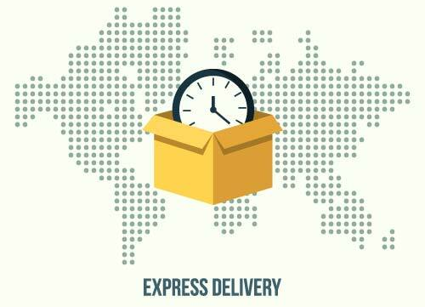
Definition
CEP activity are a natural extent of national postal services to cope with the changing customer responsiveness and important rise of e-Commerce activities.
“Express” is actually a specific modality of such services where the time-bound condition is a key part of an operator’s service.

Slide 8
Definition
Courier:
Courier services focus on delivering items (mails, boxes, etc.) door-to-door with a wide range of options and capabilities. Couriers may use self-owned, privately shared or public transportation to supply these services.
Parcel :
Parcel shipping refers to shipping lighter, smaller boxed items. Typically, parcel means packages that weigh 50 kilos or less and can be moved without assistance. They tend to standardize their practices and equipment to provide a service within an acceptable range of prices and conditions.
Express :
Express delivery is the fastest form of shipping. The customer pays an extra shipping cost for this type of delivery, as the shipment will get transported to him anywhere between 24 to 72 hours, depending on operator’s conditions.

Slide 9
Definition
Courier
Parcel
Express

Slide 10
Definition
Main differences of service conditions
Courier
CEP operators primarily draw direct, individual pickup and delivery (door-to-door).
The majority of shipments handled by courier services are delivered over short distances, but regional and international services are possible.
Valuable and cash transports are offered by special security couriers.
Parcel
Precise restrictions on the weight and volume of shipments allows standard operations hence better cost control of the service.
The transit time of the shipment is longer than express services and not guaranteed.

Slide 11
Definition
Main differences of service conditions
Express
Very fast and guaranteed transit time for shipping.
No guarantee of delivering directly as with the courier, but via handling centers.
Night express
Option available to deliver to the recipient before the start of work the next morning.
An overnight delivery is delivered overnight on the next working day.

Slide 12
A bit of history
Courier services have more or less always existed but evolved rapidly in the past decades.
In ancient history, messages were hand-delivered using a variety of methods, including runners, homing pigeons and horseback riders.
During the 17th century, the volume of communication grew to match the expansion of empires with new transportation modes to accelerate the transfer of information.
Modern industry led to the introduction of mechanized courier services and allowed the development of modalities to carry more weight, such as parcels.
All nations started developing their national postal services between the 18th and 19th century, while private sector specialized actors rose by the beginning of 20th century.
i.e.: UPS, TNT, DHL

Slide 13
Recent evolutions
In relation with the national postal service, all cities have their dedicated postal services and infrastructure, while the private sector is building its own operational network to reach their customers.
For most CEP operators, B2B share remains higher than B2C operations:
Delivery to small shops & markets, offices and institutions.
POST OFFICE
Notes:
B2B delivery share: cf Capsule 1.3.3 Retail products

Slide 14
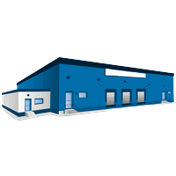
Recent evolutions
Focusing on B2C operations due to e-Commerce business rising operations has provided significant opportunities but also major challenges.
The expansion of e-Commerce services has generated an increase in flows, especially near major cities, as well as a diversity of modes that need to cohabitate.
B2B operations
B2C operations
CEP operator
B2C customers
B2B customers
The number of locations to deliver have significantly increased, while their accessibility within the city has also become more complex.
Notes:
B2B delivery share: cf Capsule 1.3.3 Retail products

Slide 15
Self-evaluation quiz
“CEP” stands for:
❑ Control Express Parcels
❑ Courier Express Package
❑ Courier Express Parcel
❑ Courier Express Product

Slide 16
Self-evaluation quiz
A “Courier” operation means that the company will deal with:
❑ mails and small packages
❑ all sorts of products that need to be delivered door-to-door
❑ mails and documents within an enveloppe for professional clients
❑ goods that are conditioned according to specific dimensions and weight

Slide 17
Operational modalities
Organisation of the distribution network
Compared to traditional delivery services, especially B2B, under contractual relationship between parties and usually a recurring frequency or routine for deliveries, CEP operations are led by the customer service response.
It means that the delivery parameters are key to performance evaluation.
Mastery of information flows is essential to monitor precisely where packages are and the timing expected to deliver customers.
On top of that, daily volume of activity is rarely known in this sector, as it is impossible to project the number of mails and packages that will be shipped on the following day.
Customer call
Operation’s planning
Routing package
Last mile transportation
Customer delivery

Slide 18
Operational modalities
Organisation of the distribution network
In order to be capable delivering items, whatever their dimensions and weight, within a few days (within hours if express), the networking of infrastructures and transportation capacity is essential for CEP operators.
Inter-region dispatch
Lots of packages to collect
Delivery rounds
Notes:
It usually looks like a “star network” with trucks organised with collection tours among clients to pick up the products (parcels and courier) then according to the delivery place identified will reach a “hub”, where another truck will either transfer the goods to another more adapted hub, or load the goods for a delivery round.

Slide 19
Operational modalities
Organisation of the delivery rounds
An additional complexity upon delivering items and recovering others to be dispatched back into the CEP network.
There is never only one customer to deliver.
Hence a full distribution plan to put in place on daily basis as the flows of products are known only for B2B customers, and not 100% guaranteed as volumes and quantities may vary.
Delivery round only
Recovery points included
Notes:
It usually looks like a “star network” with trucks organised with collection tours among clients to pick up the products (parcels and courier) then according to the delivery place identified will reach a “hub”, where another truck will either transfer the goods to another more adapted hub, or load the goods for a delivery round.

Slide 20
Operational modalities
Different types of CEP operators
Parcels can vary a lot in dimensions and weight, hence it’s very difficult to :
Anticipate the volume of operations
Delivery places to reach customers
The organisation of work
Some operators have specialized in dealing with “single parcels” services, allowing them to impose their conditions to their customers in order to standardize and accelerate operations, hence reduce unit price for their delivery service:
Maximum dimensions
Maximum weight
Cartons only (no cylinder or specific containers, difficult to stack)

Slide 21
Operational modalities
Specific infrastructures
CEP dedicated operators work with different infrastructures that classical logistics and transport stakeholders.
The need for sorting rapidly the goods and delivering them to distant places with a limited amount of time has led to adapting their hubs into a specific type of building:
logistic platform or distribution center
Notes:
Compared to traditional warehouses, there are no or very few storage equipment, very limited handling machines and lots or manual operations. Hence the flow of goods as well as the pace of operations needs to be well in place and accompanied with specific control mechanisms to secure the traceability of all products transiting through the platform.

Slide 22
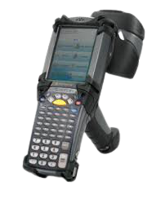
Operational modalities
Operators and equipment
Few technologies support CEP specific activities such as:
Barcode readers,
Radiofrequency terminals,
Ring scanners
Eventually digital board information are displayed above loading / unloading bays, in order to inform operators about the arrivals or departures to come, the destination of goods and level of priority.
Notes:
CEP operations are generally limited in terms of equipment, and require to organise their operations over other skills and organisational aspects. The staff have dedicated missions to fulfil in order to be as efficient as possible since they can’t automatise most activities.

Slide 23
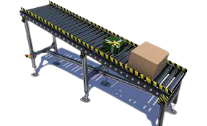
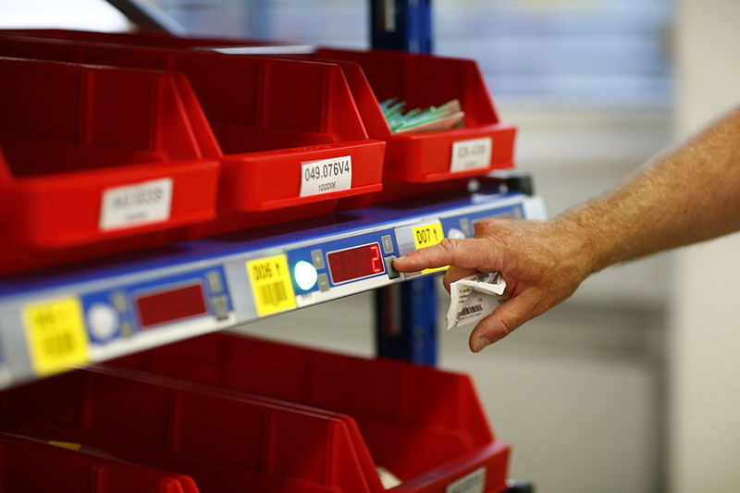
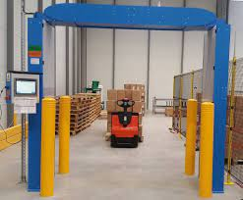
Operational modalities
Operators and equipment
Single parcel specialists:
They need to deal with pallets and cartons more efficiently, and are likely to invest on some equipment in their transit platforms, such as:
Automated conveyors,
Pick to light systems,
RFID field detectors, etc.

Slide 24
Operational modalities
Transportation modes
CEP operations, especially for the last mile delivery, can be composed of several transportation means, such as trucks of course, but also light vehicles, cargocycles, etc.
With the development of durable solutions and innovations, other traditional transport modes and new technologies are also more and more considered:
Fluvial
Rail
Drones

Slide 25
Self-evaluation quiz
CEP operations do require important equipment setup to operate:
❍ True
❍ False
Equipment required is quite basic and aims at facilitating operators’ operations in terms of ergonomy while securing traceability of items.

Slide 26
Self-evaluation quiz
CEP main operational constraints are defined by:
❑ Delivery parameters
❑ Customers’ type of activity
❑ Customer service response
❑ Volume of activity

Slide 27
Common challenges
Difficulty to manage multiple customers
e-Commerce companies are the main customers for a courier service provider.
Since a courier company associates with multiple e-Commerce businesses, it is imperative to have an efficient management system to handle orders, keep records of all distribution steps, follow-up on inquiries, etc.
Delayed deliveries
Delivering consignments on the right time windows is a real challenge that might cause a courier company to lose their clients or be sanctioned by an e-Commerce distributor.
It increases the overall shipping cost, leads to customer dissatisfaction and possibly high rates of returns (hence extra-activity and costs).

Slide 28
Common challenges
Poor visibility on delivery operations
Transparency and visibility on the courier delivery operations are key service conditions that distributors are requesting for their final customers to confirm that goods are being delivered without any delay.
A company with no visibility on the courier operations might face difficulties in delivering orders on time and lose track of its products as well as customer complaints.
Dependency on human resources
Minimizing the reliance on human resources is one of the biggest challenges for CEP operators. Human resources’ cost impacts greatly on their profitability.
Keeping customers updated
Keeping both the e-Commerce company and the end-customer updated with the status of the courier is necessary to maintain transparency. It reduces the number of calls to the customer support centre but requires important investment on digital tools.

Slide 29
Common challenges
Delivering goods without any damage
Delivering goods safely to the customers’ place remains a major challenge for CEP operators. Any damage to the product might not only impact the reputation of the courier service provider, but they might also have to pay for it.
High delivery cost
Managing courier operations, like order segregation, order allocation, selecting the right delivery vehicle, assigning drivers, planning delivery routes, and more manually might require an important team of operators.
Moreover, it also requires a proportional incompressible amount of time to coordinate these operations. This cost-control challenge led to “single parcel” specialist operators.

Slide 30
Innovations and solutions
CEP operators are major logistic innovators.
They need to look for new ideas to better reach final customers within the city, at an increasing rate and limited cost.
They need to be:
Time efficient
Cost effective
Environmentally friendly
Transparent to their partners
They’re the ones looking for solutions such as click & collect in pick-up lockers, may it be exclusive or in public place, etc.
Notes:
Environment friendly essentially means to respond to rapidly evolving regulations.
Click & collect: allows to focus their delivery rounds on B2B customers, easier to reach with bulk deliveries.
Pick-up lockers: same benefits, except for the interaction with a person to manage the reception of the goods.

Slide 31
Innovations and solutions
CEP operators are the most impacted with parcel returns, hence need to be closely related to their customers in order to manage those goods without affecting their operational space and pace.
The need for interconnected software is very high.
Extra operations on the goods allow them to provide extra-services and tariffs, such as:
Relabeling
Reconditioning
Dismantling
Sorting to destruction or recycling
Etc.

Slide 32
Capsule’s validation quiz
The following quiz represents 5 questions you will have to answer to confirm your understanding of the present capsule.
Each correct answer is worth 1 point. No point for errors.

Slide 33
Self-evaluation quiz
Question n°1 :
What makes CEP operations difficult to anticipate ?
B2C operations, mainly e-commerce clients
Variety of goods to handle
Type of vehicles available for delivery rounds
B2B volume of operations

Slide 34
Self-evaluation quiz
Question n°2 :
What is the most essential aspect that CEP operators need to invest on in order to remain competitive and profitable?
New technologies, especially transport modes
Geographic positioning
Dealing with customers’ complaints
Traceability of goods throughout their operations

Slide 35
Self-evaluation quiz
Question n°3 :
How do CEP operators better manage their operations when working on Parcel services?
Providing containers to their clients before operating
Managing loading and unloading operations
Imposing their conditioning criteria prior to operations
Investing on equipment to fasten the work pace

Slide 36
Self-evaluation quiz
Question n°4 :
Indicate below what are the main challenges for CEP operators:
Visibility on operations
Securing operational costs
Dealing with traffic regulations
Goods’ damage prevention
Low-budget customers to deal with
New technologies investments
Human resources dependency
Traceability of all operations

Slide 37
Self-evaluation quiz
Question n°5 :
What is the difference between Courier and Express services?
Express services focuses on time-bound delivery conditions
Courier have established limitations on the products they handle
They both impose their conditioning criteria prior to operations
Both services do handle all types of products

Slide 38
Retry ?
Validate and quit capsule

