Slide 1
CHAPTER 1: The environment of Last Mile Distribution logistics
UNIT 3: Variety of product flows in the Last Mile Distribution
Capsule
1.3.1
Different types of products and flows

Slide 2
To be done prior to this capsule:
This capsule builds the basis for capsules 1.3.2, 1.3.3, 1.3.4, 1.3.5 and 1.3.6. It should therefore be done before these capsules.
Capsule linked with:
Link with the topics of capsules 1.2.1, 1.2.4, 1.4.1, 1.4.4, 2.1.1, 2.3.2, 2.5.3, 2.5.4, 2.5.5.
Authors:
AFT, SUSMILE consortium member

Slide 3
Objectives of the capsule
This module aims to present the different types of products and their logistic flows in urban context.
After completing this module, the learner should be able to list the main types of products, their specificities as well as the main characteristics of products that have an impact on the organisation of transport. The learner should also understand that this leads to a diversity of organisations in a city.
Category | E-learning | EQF
 |  | 4 | 5 | 6
 |  | X | X | X
Exercises included | YES
Effort for the capsule | Content 25 Min. | Exercises 15 Min. | Extra material 0 Min.

Slide 4
Content of the capsule
Introduction to different types of products and activities in the city
Overview of their logistics characteristics
Logistics challenges in a city

Slide 5
Elements of understanding
This capsule is an e-learning content, with animated messages and contents. In order to take full advantage of its content, please switch to “presentation” mode in order to browse all the key messages.
When looking for a definition or additional content, click on the following icon:
A small message box will open to provide additional information.
In case of doubt, you may refer to your teacher/professor or use the contact details of this MOOC designer team.

Slide 6
Introduction
What is a city ?
It is a place where many people live, with many houses, stores, businesses, etc.
In order to make this environment functional and in adequation with population density, there are lots of public services that have been concentrated, while private sector activities are adapting their model to reach all their clients.

Slide 7
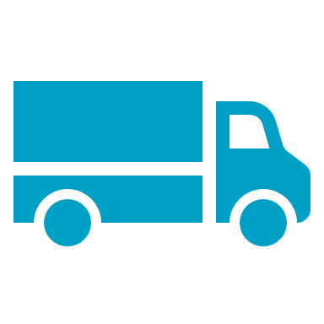
Introduction
Of course, we focus on the physical products that circulate in the urban environment, but many other 'flows' also affect the general organisation of a city and will have an impact on it:
Information:
Data collection for businesses, Wifi networks, traffic lights, etc.
All road users
People:
workers, parents, children, etc.

Slide 8
Introduction
There are two main types of products that will enter the city:
Business to business
Business to Customer
All the products that are destined to be manipulated again at least once for either a transformation, unpacking, display, etc.
Also called « Producer-related » flows
All the products that will reach the end-user as there shall be no other movements once the final customer is reached.
Also called « Consumer-related » flows

Slide 9
Introduction
These main types of flows can however be further decomposed with the evolution of society and new ways of consuming:
1
2
3
1/ Second-hand flows to sell or donate to another end-user.
2/ Returned products due to various reasons.
3/ Destruction or recycling of unused items.

Slide 10
Introduction
When overviewing the products’ movements from a business perspective, to reach the final consumer, the number of steps can increase significantly when entering the city:
City
Distribution
Due to the high density of actors to position themselves close to the final consumers, it tends to generate lots of movements in a limited environment.
Flow of goods from
outside the city
Citizen
Logistic terminals
Commercial
Manufacturing
And reverse logistic movements are also to be considered.

Slide 11
Introduction
Which leads to clarifying…
…the flows exiting the city !
Waste
The waste produced by the city is numerous, it comes from different types of actors and is treated or used differently afterwards.
Energy wastes
Conditioning & packing
Construction residuals
Damaged products
None of the above will be collected in the same way and even within a waste category, the actions to be taken to recover and recycle the waste are not standard.

Slide 12
Self-evaluation quiz
What are the different types of logistic flows in the city:
❑ Forward and reverse flows
❑ Business to Business and Business to Customer
❑ Standard and Express deliveries
❑ Normal distribution and waste management

Slide 13
Self-evaluation quiz
Which trends are pushing for the development of urban logistics:
❑ High population density
❑ e-commerce volume of activity
❑ Modernizing city equipment and infrastructures
❑ New technologies and transport modes

Slide 14
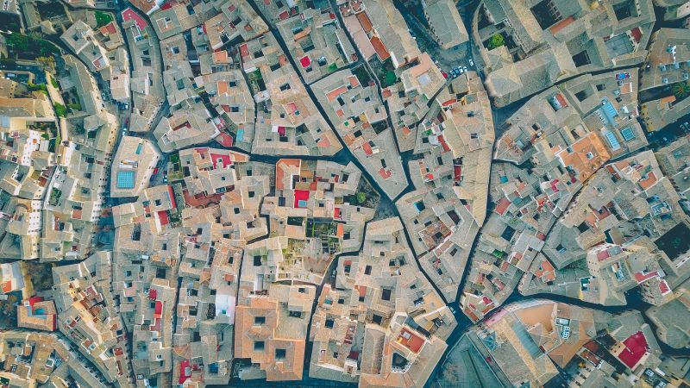
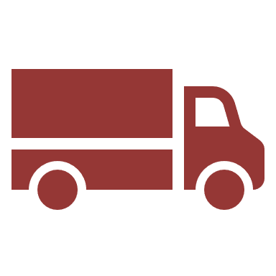
Products specificities
Product flows review
Let us imagine what a logistic organisation could look like, in order to deliver its products in the city.
Many movements, different objectives
A complex network
Shop delivery
Delivery staff
Waste recovery
(single neighbourhood)
Postman
Construction and road works

Slide 15
Products specificities
It is obvious that if we put all the logistics operations next to each other, we realise how difficult it would be to tackle them all with one approach, whether it is to optimise costs, timing or the organisation itself..
In the urban environment, we tend to see:
One urban logistic
Several last mile logistics
...which explains why it is necessary to break down the functioning of the city around the families of products that pass through its streets.
It is necessary to understand their constraints, their issues and their economic model, in order to study how to improve their respective logistics.

Slide 16
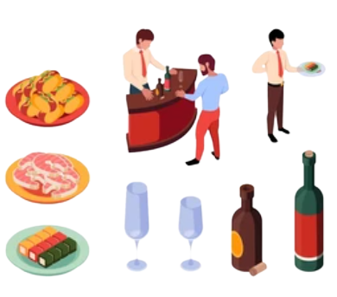
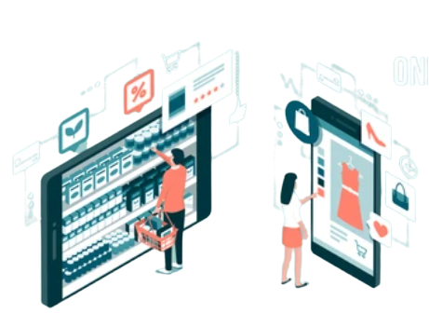
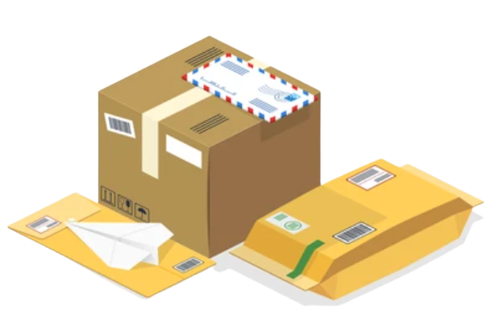
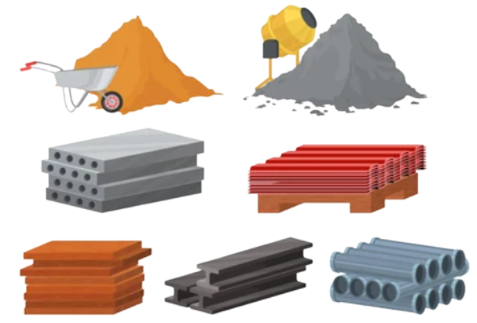
Products specificities
What are the products that flow through the city ?
3
2
4
Catering products
Waste
Retail products
1
5
Mail & packages
Construction works materials

Slide 17
Products specificities
1
Mail & packages
Every one of us has received at least once a mail or a box. May it be related to private communications or when ordering products online.
Even enterprises do receive mails and packages.
Which means that every single mail location in the city must be reachable by this type of service.
The access to all such destinations requires hand-to-hand delivery, while the volume of packages and mails are often important considering population density.

Slide 18
Products specificities
2
Retail operations
From the artisanal shop to the city centre supermarket, all sizes of retailers can coexist in the urban context.
They offer a specific range of products, from the highly specialised and unique item (e.g. a branded laptop) to the complete offer (e.g. commodities, food, etc.).
Their supply routes are therefore not from the same sources and can hardly be combined due to the volumes to be brought into the city.
Due to the size of the streets, their accessibility, historical monuments and other infrastructure parameters, their access can be difficult for large vehicles.
Due to commercial use and frequent customer traffic, delivery windows are often narrow.

Slide 19
Products specificities
3
Hotel & restaurant services
Hotel and restaurant services are part of the services category and are closely linked to tourism.
They attract many customers because of their specialities, their identity and the specific level of service they offer according to the type of customers they target.
Their supply frequency is very high, due to perishable and health-related products.
Their infrastructure is often historical and embedded in other existing buildings, and therefore not dedicated to logistics delivery services.

Slide 20
Products specificities
4
Waste management
Waste is generated by all other activities and collected by various means.
It is generated at an increasing rate with the population density and consumption trends in modern societies.
It is not supposed to be mixed so as not to compromise the process of reuse, treatment or recycling of waste.
They are generally perceived negatively by the neighbourhood, so collection rounds are usually organised at specific times, outside of traditional traffic and working hours.
Collection rounds are difficult to predict but as frequent as possible due to public health potential consequences.

Slide 21
Products specificities
5
Construction works
There are various construction sites, from buildings to road infrastructure, all of which will affect the city's environment (traffic, diversions, blockages, etc.).
This activity requires a range of experts, not necessarily attached to the same company, which means that there are long lead times for their availability.
The volume of equipment and materials is always large and requires space around the site.
The frequency of supply is irregular, depending on the type of materials and the need for the work to be undertaken.
The work may be initiated by different actors and requires strong multi-stakeholder coordination.

Slide 22
Self-evaluation quiz
What logistics factors do the above categories of products will have in common to manage their distribution or recovery model:
❑ Sourcing frequency
❑ Planning of operations
❑ Neighbourhood perception
❑ Timing for operations

Slide 23
Self-evaluation quiz
Which of the products categories expressed is typically a “reverse logistic flow”?
❑ Waste management
❑ Construction works
❑ Hotels and restaurants services
❑ Retail business

Slide 24
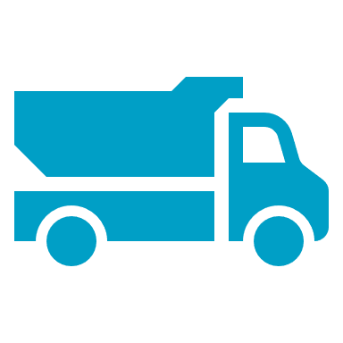
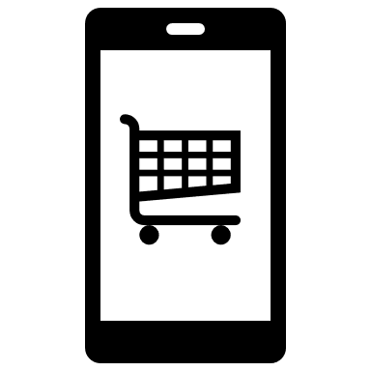
Logistics challenges in the city
All of the actors presented will face common challenges in the city, which will have an impact on their organisation and efficiency, and therefore on their business model.
Congestion & parking
Land use
Regulations
Green logistics
E-commerce

Slide 25
Logistics challenges in the city
Congestion & parking
Interaction with many different stakeholders
Buses, private cars, motorcycles, etc.
Peak hours to deal with, due to commuting
People heading for schools, work, tourists, etc.
Exclusion rules for specific transport modes during daytime hours (i.e.: trucks)
High risks for congestion
Protests, works, traffic disorders, etc.
Need for dedicated space to deliver, not always available
Lack of understanding from civilians and other actors, limited or inaccessible space, etc.

Slide 26
Logistics challenges in the city
Land use
Land use patterns determine urban goods movement
Industrial or residential areas, underground public transports, etc.
High density is seen as sustainable for cities but implies higher costs and less reliability for the distribution of goods
Cost of infrastructures, time to access all points of delivery, etc.
Displacement of logistic facilities to the outskirts of the city
Warehouses or logistic platforms, negative perception of large trucks, etc.
Peri-urban logistic development and consequences for large cities
Cumulative risks of congestion, differences in regulations, etc.

Slide 27
Logistics challenges in the city
Green logistics
Road transportation is the most polluting mode per unit of distance travelled
Limited alternatives for urban deliveries with capacity and rapidity
Decline of air pollution due to better engines but important investment costs
Technologies stability to confirm, heavy vehicles to replace for the transport sector
Fleet factors impacting significantly the ecological impact in the city
Urban freight is on average twice as polluting as intercity freight transport
Vehicles age, size, operating speeds and idling are related to delivery options
Reverse logistics trend to increase significantly
Tendency to consume more means more waste to discard, may it be for recycling or destruction

Slide 28
Logistics challenges in the city
E-commerce
The significant growth of e-commerce is reflected in an increase in
overall consumption.
e-Commerce is not only an alternative way of shopping: people tend to consume more
This new way of consuming translates into ‘distributive consumption’, as end-users demand new forms of urban distribution
Being delivered ‘’when and where we want’’ generates new product flows for professionals and makes it more difficult to rationalise these deliveries
Creation of new delivery points
Private adresses, pick-up points, etc.
Higher return rates, implying reverse logistic strategies
Brand image and competition pressure, additional infrastructure costs, etc.

Slide 29
Logistics challenges in the city
Regulations
The urban context implies divergent priorities for different stakeholders
The possibilities for collaboration open up new areas of engagement and the intervention of new stakeholders in the operational model
Such as public administration, associations, etc.
The increased diversity of transport modes requires regulation, but must preserve their flexibility and respective objectives
In particular individual mobility of citizen, public transport, etc.
Arbitrary decisions and lack of harmonisation between neighbouring cities lead to negative and unintended consequences
Authorized circulation hours, trucks specifications or engines, etc.

Slide 30
Logistics challenges in the city
The logistics environment of each city must be approached as an environment in its own right with its own rules.
There is no single logistics model
The products and players have evolved along with the evolution of society itself.
We need to understand the challenges of the business environment in parallel with the business and strategic ambitions of the company, because all of this is closely linked in the urban context.

Slide 31
Capsule’s validation quiz
The following quiz represents 5 questions you will have to answer to confirm your understanding of the present capsule.
Each correct answer is worth 1 point. No point for errors.

Slide 32
Self-evaluation quiz
Question n°1 :
Which of the below factors affects most hotel and restaurant services?
e-commerce evolution of behaviours
Congestion and parking to access premises
Regulations on products and sourcing means
Land use and cost of infrastructure
All of the above

Slide 33
Self-evaluation quiz
Question n°2 :
What definition corresponds best to the term ‘distributive consumption’?
Demand for a technologically advanced delivery method
Demand for a multimodal delivery
Demand for more delivery options
Demand for more traceability regarding the mode of delivery

Slide 34
Self-evaluation quiz
Question n°3 :
What is the main obstacle to the conversion of stakeholders to green logistics?
Modified operating conditions
Investment costs
Increased competition
Regulation constraints

Slide 35
Self-evaluation quiz
Question n°4 :
Indicate below all the urban logistic challenges that affect the business environment in the city:
Converging priorities of stakeholders
Securing freight and operators
Cyclologistics operations
Arbitrary regulatory decisions
Access to delivery points
Transport fleet flexibility
Increased demand from e-commerce
Outskirts logistic displacement

Slide 36
Self-evaluation quiz
Question n°5 :
What is likely to influence the operational model of a business in the city environment?
Sourcing frequency
B2B or B2C strategy
Proximity to the city center
Accessibility of premises to delivery modes
Reverse logistic flows

Slide 37
Retry ?
Validate and quit capsule

